Slide 1

Suspected Child Abuse and Neglect
Author: Gillian Morantz MD

Slide 2
Learning Objectives
Definitions
Epidemiology
Risk factors
Red flags
Investigations
Management
Consequences
Reporting
Notes:
Notes:
We will review:
Definitions of different forms of abuse and neglect. We are going to focus on physical and sexual abuse today
Prevalence of child abuse
Risk factors known to be associated with abuse and neglect
Red flags on history, presentation and examination for physical and sexual abuse
Recommended investigations in suspected abuse
Emergency setting management
Consequences of abuse and neglect for the victims
Need for reporting to authorities

Slide 3
Disclaimer
This presentation provides a brief overview of when to suspect and how to evaluate a child for physical and sexual abuse
You should use caution when interpreting suspicious findings
In a case of suspected abuse, you should consult with a pediatrician with experience in abuse evaluations whenever possible

Slide 4
Definition:
Emotional and psychological abuse
Failure of parent or caregiver to provide an appropriate or supportive environment
Acts that are likely to damage a child’s physical or mental health, or development
Examples: restriction of movement, belittling, blaming, threatening, frightening, discriminating, ridiculing, calling on evil spirits, and not allowing to eat or drink
Notes:
Notes: These following definitions are adapted from the WHO and International Society for Prevention of Child Abuse and Neglect, also known as ISPCAN. ISPCAN is a good resource for information. In these definitions, child refers to an individual < 18 years old as per the UN definition
Specific References: World Health Organization & International Society for Prevention of Child Abuse and Neglect (2006). Preventing Child Maltreatment: a guide to taking action and generating evidence. [http://www.ispcan.org/resource/resmgr/docs/preventing_child_maltreatmen.pdf] Accessed August 23, 2011.
United Nations Convention on the Rights of the Child, 1989. [http://www.unicef.org/crc/] Accessed November 11, 2011.

Slide 5
Suspect psychological or emotional abuse when…
Lack of attachment between infant and parent
Lack of responsiveness to environment
Poor growth
Parent is highly critical and negative toward the infant/child
Notes:
Specific References: World Health Organization & International Society for Prevention of Child Abuse and Neglect (2006). Preventing Child Maltreatment: a guide to taking action and generating evidence. [http://www.ispcan.org/resource/resmgr/docs/preventing_child_maltreatmen.pdf] Accessed August 23, 2011.

Slide 6
Definition: Neglect
Failure of parent or caregiver to provide for development and well-being of the child:
  health
  education
  emotional development
  nutrition
  shelter and safe living conditions
This does not include cases where poverty is the cause
Notes:
Specific References: World Health Organization & International Society for Prevention of Child Abuse and Neglect (2006). Preventing Child Maltreatment: a guide to taking action and generating evidence. [http://www.ispcan.org/resource/resmgr/docs/preventing_child_maltreatmen.pdf] Accessed August 23, 2011.

Slide 7
Suspect neglect when…
Significantly below height/weight for age
Inappropriate clothing for weather
Lack of safe, sanitary shelter
Lack of necessary medical and dental care
Poor hygiene, including lice, body odour, scaly skin, rat bites
Child reports no caretaker in the home
Child abandoned or left with inadequate supervision
Notes:
Editors Note: Here again one must differentiate between neglect vs. poverty causing social situations in which the above occur. It is important to note the bond between caregiver and child and help to improve the underlying social circumstances of families to improve child health.
Specific References: World Health Organization & International Society for Prevention of Child Abuse and Neglect (2006). Preventing Child Maltreatment: a guide to taking action and generating evidence. [http://www.ispcan.org/resource/resmgr/docs/preventing_child_maltreatmen.pdf] Accessed August 23, 2011.

Slide 8
Definition: Physical Abuse
Intentional use of force against a child that results in injury or the possibility of injury
May occur in the context of punishment
Examples: hitting, beating, kicking, shaking, biting, strangling, scalding, burning, poisoning, drowning, suffocating, and putting hot peppers/chilies in a child’s mouth
Notes:
Notes: We will talk more about physical abuse in a few moments.
Specific References: World Health Organization & International Society for Prevention of Child Abuse and Neglect (2006). Preventing Child Maltreatment: a guide to taking action and generating evidence. [http://www.ispcan.org/resource/resmgr/docs/preventing_child_maltreatmen.pdf] Accessed August 23, 2011.

Slide 9
Definition: Sexual Abuse
Involving a child in sexual activity that s/he:
  doesn’t understand , or
  is unable to consent to, or
  violates the laws or social taboos of society
By an adult or another child who is older or at a higher developmental stage
Examples: intercourse, sexual touching, exposure of genitals, penetration with objects/hot peppers
Notes:
Notes: We will talk more about sexual abuse later in the presentation.
Specific References: World Health Organization & International Society for Prevention of Child Abuse and Neglect (2006). Preventing Child Maltreatment: a guide to taking action and generating evidence. [http://www.ispcan.org/resource/resmgr/docs/preventing_child_maltreatmen.pdf] Accessed August 23, 2011.

Slide 10
Epidemiology
Worldwide:
  In 2002, 31 000 children less than 15 years were murdered
  20% of women and 5%-10% of men report sexual abuse as children
In the U.S. and Europe, 5-35% of children physically abused, but <5% reported
In a study conducted in several African countries, 64% of children report moderate and 43% of children report severe physical abuse
Children less than 5 most at risk of severe injury or death
Notes:
Notes: The actual prevalence of abuse and neglect is not well known worldwide. Very little data has been collected on abuse and neglect and it is often subject to underreporting. The true extent of the problem is unknown.
Specific References: Gilbert, R et al. Burden and consequences of child maltreatment in high-income countries. Lancet. 2009; 373:68. World Health Organization & International Society for Prevention of Child Abuse and Neglect (2006). Akmatov, MK. Child abuse in 28 developing and transitional countries-results from the Multiple Indicator Cluster Surveys. International Journal of Epidemiology. 2011: 219-227.

Slide 11
Risk Factors
Family characteristics:
  Poverty, domestic violence, social isolation, several young children
Parental (caregiver) characteristics:
  History of abuse or neglect as child, mental illness, substance abuse
Child characteristics:
  Unwanted pregnancy, prematurity, disability or deformity, orphan
Notes:
Notes: Child abuse and neglect can occur in any type of family environment. However, there are some characteristics of the family, parents and children which increase the risk of abuse or neglect.
Specific References: Asnes, A. et al. Managing Child Abuse: General Principles. Pediatrics in Review. 2010;31;47

Slide 12
Possible presentations of abuse
A direct allegation (‘disclosure’) made by the child, a parent or some other person
For younger children or when the parent/caregiver is the abuser, disclosure is often not made. You must rely on:
  Assessment of explanations
  Detection of injuries, symptoms or behaviours which are suggestive of abuse
  Observations of parent-child interaction
Notes:
Notes: In cases where a disclosure (direct allegation) is made then your job is to investigate and document the injuries, treat conditions in need of emergency medical care, ensure the safety of the child/children, notify the authorities and arrange follow-up. Often no disclosure is made in cases of young children, when the caregiver is the abuser or when the caregiver is not aware of the abuse. In these cases, you must consider the possibility that abuse is taking place based on the adequacy of the explanation given, the types of injuries, symptoms and behaviours of the child, and your observations of parent-child interactions.

Slide 13
Physical Abuse

Slide 14
Quiz Question 1
Which of the following factors on history raise the suspicion of physical abuse?
  Delay in presentation
  Changes in history
  History inconsistent with injury
  All of the above
Notes:
Correct Answer: All of the above

Slide 15
Case 1: Samuel, 4 week old boy
Baby brought in because he is not moving his left leg and he seems to cry when it is moved
First noticed 2 days ago
Mother states that she thinks he fell off a table 3 nights ago
On exam, no swelling, deformity, or bruising
An XR shows fracture of distal left tibia
Notes:
Notes: Let’s consider the case of Samuel…

Slide 16
Discussion Points
How concerned are you about physical abuse?
What are red flags for physical abuse in this case?
Notes:
Notes: This case is very concerning for physical abuse. A number of the historical elements in this case are suspicious for abusive injury. These include delay in presentation (the signs of injury were noted 2 days ago), the explanation is vague (mother thinks he may have fallen off a table), the explanation is inconsistent with Samuel’s developmental capability (he is only 4 weeks old, unable to roll off a table)

Slide 17
Red flags on history for physical abuse…
Delay in presentation
No or vague explanation for significant injury
Changes made to important details of explanation
Explanation is inconsistent with age, pattern or severity of the injury
Explanation is inconsistent with child’s physical or developmental capabilities
Different witnesses provide different explanations
Notes:
Specific reference: Kellogg, N. Evaluation of Suspected Child Physical Abuse. Pediatrics. 2007;119:1232-1241.

Slide 18
Obtaining a history when physical abuse is a possibility…
Ask for details of the mechanism of injury
Document clearly
Avoid “leading questions”
  e.g. ask: “How was your child injured?” rather than “Is it possible he/she fell from ___?”
Ask older children about injury
  Preferably separate from parents/caregivers
Avoid accusatory tone; avoid repetitive interviews
Social history
Notes:
Notes: Need to make sure that the mechanism of injury (how the child got hurt) is a possible explanation for the injury. Make sure you write down a legible history in case the story changes with time or the case becomes a legal case. Don’t ask leading questions which might suggest possible mechanisms of injury to the caregiver. If they don’t know what caused the injury, document that. If it is possible, try to ask older children about what happened away from their parents. Avoid an accusatory tone because it may make parents defensive and you shouldn’t assume that you know what happened. Try to avoid repetitive interviews as this can be distressing and confusing to children. A social history is helpful, ie who lives at home, who takes care of the child, use of alcohol or drugs.
Specific References: Aggarwal K, Dalwai S, Galagali P, Mishra D, Prasad C, Thadhani A; Child Rights And Protection Program (CRPP) of Indian Academy of Pediatrics (IAP). Recommendations on recognition and response to child abuse and neglect in the Indian setting. Indian Pediatr. 2010 Jun;47(6):493-504. Sirotnak, AP et al. Physical Abuse of Children. Pediatrics in Review. 2004; 25(8): 264-277.

Slide 19
Red flags on physical exam for child abuse
Evidence of neglect e.g malnutrition, untreated infections, rat bites
Suspicious skin injuries:
  Bite or pinch marks
  Burns: cigarette, immersion, rope
  Bruises: patterned, on infants
Don’t forget to look behind ears, in mouth, genitalia
Draw on body diagram or take pictures (if possible) with consent
Notes:
Notes: Evidence of neglect includes malnutrition, poor growth or poor hygiene. Suspicious skin injuries include bite or pinch marks. Bite marks are often oval shaped. Some bites may be caused by another child. Burns that are particularly concerning for abuse include cigarette burns which are usually round, immersion injuries on both hands or lower extremities from being dunked in hot water, or rope burns from being tied up. We will discuss suspicious bruises in a few moments.
Specific Reference: Kellogg, N. Evaluation of Suspected Child Physical Abuse. Pediatrics. 2007;119:1232-1241.

Slide 20
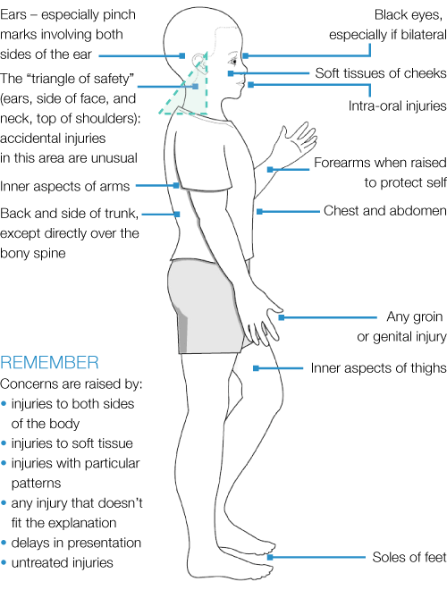
http://www.cpdt.org.uk/tab02/2_4_1_0.htm
Notes:
Notes: Typical features of child abuse injuries
Specific Reference: Child Protection and the Dental Team. Recognizing abuse and neglect [http://www.cpdt.org.uk/tab02/2_4_1_0.htm] Accessed November 15, 2011.

Slide 21
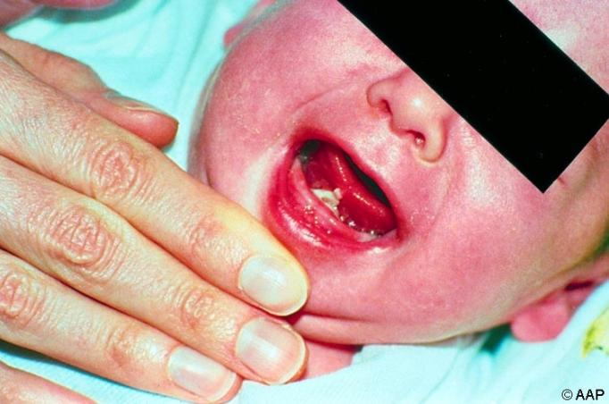
Maguire, S. Which injuries may indicate child abuse? Arch Dis Child Educ Pract Ed. 2010, 95: 170-177.
Notes:
Notes: be careful to look in the mouth at the three frenulum (tissue attaching the upper lips to the gums and tissue attaching the tongue to the floor of the mouth). A torn frenulum can be caused by trauma to the mouth or an object inserted forecefully ie bottle. The finding of a torn frenulum in a child < 2 years of age, without adequate explanation, raises concern for abuse.
Specific reference: Maguire, S. Which injuries may indicate child abuse? Arch Dis Child Educ Pract Ed. 2010, 95: 170-177.

Slide 22
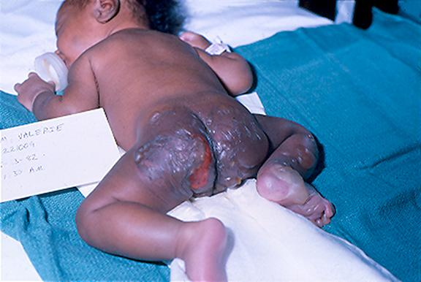
Immersion burn
www.pediatriccareonline.org
Notes:
Note: This distribution of burn is typical of a forced immersion in hot or boiling water.
Specific Reference: [www.pediatriccareonline.org] Accessed February 7, 2012

Slide 23
Quiz Question 2
How many days old is a green bruise?
  0-1 day
  1-5 days
  5-7 days
  None of the above
Notes:
Notes: Correct answer is none of the above. The age of a bruise cannot be determined accurately.
Specific reference: Kellogg, N. Evaluation of Suspected Child Physical Abuse. Pediatrics. 2007;119:1232-1241.

Slide 24
Bruises in physical abuse
More often on surfaces away from bony prominences, e.g. head, face, neck, buttocks, hands, upper arms
Well-demarcated pattern, e.g. belt buckle, fingers
Any bruise on a non-ambulatory infant is concerning
Notes:
Notes: Accidental bruises usually occur over bony areas, like the shins and forehead. Bruises that are inflicted on a child are often over soft areas like the cheeks or abdomen, or unusual areas like the ears and neck.
References: Sirotnak, AP et al. Physical Abuse of Children. Pediatrics in Review. 2004; 25(8): 264-277.

Slide 25
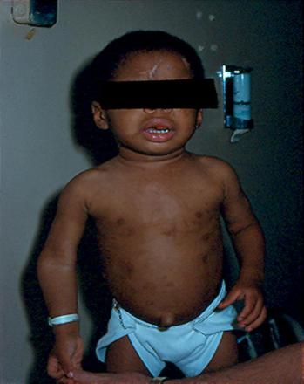
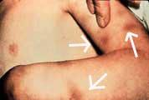
Some suspicious bruises
Multiples bruises
Fingertip bruises
http://www.med.pdn.ac.lk/departments/forensic/BUDHUSARANAI/blast-ansr.html
www.pediatriccareonline.org
Notes:
Specific reference: Kellogg, N. Evaluation of Suspected Child Physical Abuse. Pediatrics. 2007;119:1232-1241.
[http://www.med.pdn.ac.lk/departments/forensic/BUDHUSARANAI/blast-ansr.html] Accessed November 15, 2011.
[www.pediatriccareonline.org] Accessed February 17, 2012.

Slide 26
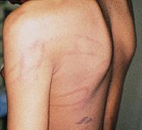
Patterned bruise
http://www.aafp.org/afp/2000/0515/afp20000515p3057-f2.jpg
Notes:
Note: may represent bruises from a cord or belt.
Specific Reference: [http://www.aafp.org/afp/2000/0515/afp20000515p3057-f2.jpg] Accessed February 7, 2012

Slide 27
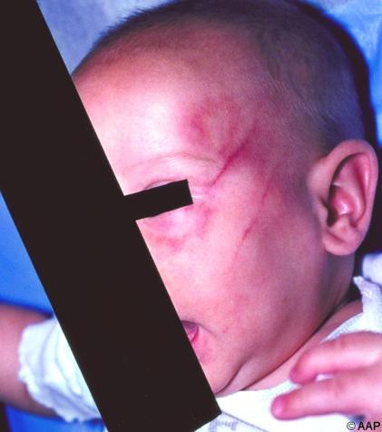
Any bruise on a young infant
www.pediatriccareonline.org
Notes:
Note: Any bruise on an infant who is not yet mobile (not crawling or scouting) is very concerning because they are not able to generate enough force to cause the bruise by themselves. Any bruise on a non-mobile infant raises suspicion of abuse if an appropriate accidental explanation is not provided. The possibility of abuse must be considered.
Specific Reference: Maguire, S. Which injuries may indicate child abuse? Arch Dis Child Educ Pract Ed. 2010, 95: 170-177; [www.pediatriccareonline.org] Accessed February 7, 2012

Slide 28
Bruising: Differential diagnosis
Bleeding disorders
Salicylate (aspirin) ingestion
Vasculitis
Slate grey patch
Don’t forget to look for signs of disease process e.g. enlarged liver or spleen
Cultural practices
Notes:
Notes: Vasculitis is the inflammation of blood vessels. A slate grey patch was formerly known as a “mongolian spot”
Specific reference: Endom, E. Differential diagnosis of suspected child abuse. UpToDate. 2011. www.uptodate.com Accessed November 11, 2011

Slide 29
Investigations for bruising
Complete blood count (platelets)
Coagulation studies
If highly suspicious and child < 2 years, consider investigations for fractures and head injury
Notes:
Note: in order to rule out other causes of bruising, you should consider these investigations if possible. Other investigations for fractures and head injury will be discussed later.
Specific Reference: Kellogg, N. Evaluation of Suspected Child Physical Abuse. Pediatrics. 2007;119:1232-1241.

Slide 30
Quiz Question 3
Which of the following fractures is most suspicious for physical abuse?
  Linear skull facture
  Rib fracture
  Spiral tibia fracture
  Humerus fracture
Notes:
Notes: Correct answer is rib fracture. One of the most suspicious injuries in children is rib fractures, especially posterior rib fractures. The other types of fractures are common childhood fractures that are often seen with accidental injury and sometimes seen in abuse.

Slide 31
Red flags for abusive fractures
Multiple fractures
Fractures in various stages of healing
Fractures of the humerus or femur in a child who is not yet walking or crawling
Fractures of the ribs, spine, complex skull and scapula
Growth plate separations
Metaphyseal corner “bucket handle” fractures
Notes:
Specific reference: Pandya, NK et al. Child Abuse and Orthopaedic Injury Patterns: Analysis at a Level I Pediatric Trauma Center. Journal of Pediatric Orthopedics. 2009; 29(6): 618-624.

Slide 32
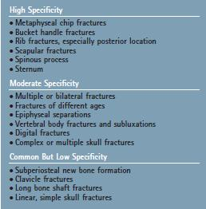
Fractures: Specificity for abuse
Sirotnak, AP et al. Physical Abuse of Children.
Pediatrics in Review. 2004; 25(8): 264-277.
Notes:
Specific Reference: Sirotnak, AP et al. Physical Abuse of Children. Pediatrics in Review. 2004; 25(8): 264-277.

Slide 33
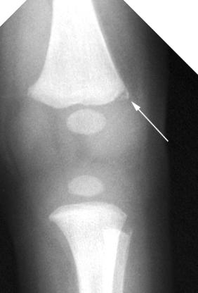
Metaphyseal corner fracture
http://www.meddean.luc.edu/lumen/MedEd/radio/curriculum/Pediatrics/child_abuse.htm
Notes:
Notes: Often occurs as a result of shearing forces such as from shaking or yanking
Specific Reference: Use and utility of radiology in the work up of suspected child abuse.
[http://www.meddean.luc.edu/lumen/MedEd/radio/curriculum/Pediatrics/child_abuse.htm] Accessed November 11, 2011.

Slide 34
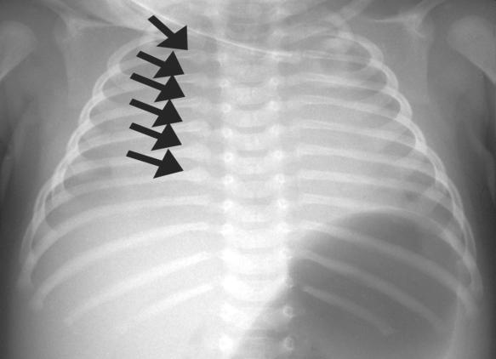
Posterior rib fractures
http://radiographics.rsna.org/content/23/4/811/F17.large.jpg
Notes:
Note: usually occurs in the context of squeezing the thorax
Specific Reference: radiology.med.sc.edu [http://radiographics.rsna.org/content/23/4/811/F17.large.jpg] Accessed November 11, 2011.

Slide 35
Fractures: Differential Diagnosis
Metabolic bone disease
  e.g. Rickets
Osteogenesis imperfecta
Bone tumour or cancer
Infection
  Syphilis, osteomyolitis
Look for signs of underlying disease!
Notes:
Notes: Ricket’s is a condition with weak bones caused by vitamin D deficiency, osteogenesis imperfecta is an inherited disorder of bone weakness. Some tumours or infections can cause pathologic fractures, which are fractures that occur from minor injury
Specific Reference: Scherl, SA et al. Differential diagnosis of the orthopedic manifestations of child abuse. UpToDate. 2011 [www.uptodate.com] Accessed November 11, 2011

Slide 36

Investigations for fractures
Skeletal survey for children < 2 years
Consider repeat skeletal survey in 2 weeks
Calcium, alkaline phosphatase, phosphorus, vitamin D, and parathyroid hormone
Sirotnak, AP et al. Physical Abuse of Children.
Pediatrics in Review. 2004; 25(8): 264-277.
Notes:
Notes: for all children less than 2 years of age with suspicious injuries, you should consider doing a skeletal survey. The xrays in a skeletal survey are found in the blue box. A skeletal survey looks for signs of acute or healing fractures which might suggest whether other injuries are present. A repeat skeletal survey may pick up fractures not seen on the initial films. Rib fractures, for example, are often best picked up on a repeat film when they are in the healing stages. A bone scan is sometimes used as an alternative to a skeletal survey. Blood tests can be considered to rule out metabolic bone diseases which are on the differential diagnosis of fractures.
Specific reference: Kellogg, N. Evaluation of Suspected Child Physical Abuse. Pediatrics. 2007;119:1232-1241.
Sirotnak, AP et al. Physical Abuse of Children. Pediatrics in Review. 2004; 25(8): 264-277.

Slide 37
Case 2: Sara, 3 month old girl
Brought to emergency room for irritability and vomiting X 3
Reported episode of apnea
On exam, Sara found to be irritable, and has faint bruises on back
When asked, mother recalls a fall from her arms 2 days ago
Notes:
Notes: apnea means a pause in breathing

Slide 38
Discussion points
How concerned are you about physical abuse?
What are red flags for physical abuse in this case?
What type of injury are you most concerned about?
Notes:
Notes: Discussion about what is concerning here: Bruising of head, delay in presentation, episode of apnea (pause in breathing) and signs of brain irritation with vomiting and irritability. All of these are suggestive for abusive head injury

Slide 39
Red flags for abusive head trauma:
Younger age
Acute or chronic injury with inconsistent, inadequate, changing or no explanation
An unexplained symptomatic head injury in a child who was well when last seen
Need a high index of suspicion:
  35-40% no external signs of injury
  50% have previously visited a doctor with signs of abuse that were missed
Notes:
Notes: Once again, the history is very important. An inconsistent or vague history is concerning, as is a delay in presentation.
Specific Reference: CPS, Multidisciplinary Guidelines on the Identification, Investigation and Management of Suspected Abusive Head Trauma, 2008. Kellogg, N. Evaluation of Suspected Child Physical Abuse. Pediatrics. 2007;119:1232-1241.

Slide 40
Abusive head trauma
Often shaking is the mechanism
Most common injuries:
  Subdural hematomas, multiple/different ages
  Complex skull fractures
May be associated with:
  Retinal hemorrhages
  Apnea
  Other suspicious injuries, e.g. rib fractures, bruises
Notes:
Notes: This used to be called “shaken baby syndrome” but is now usually referred to as “abusive head trauma” or “non-accidental head trauma” because shaking is not the only mechanism of injury.
Specific Reference: Kellogg, N. Evaluation of Suspected Child Physical Abuse. Pediatrics. 2007;119:1232-1241.

Slide 41
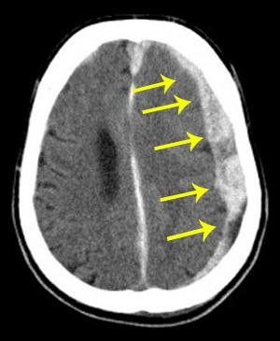
Subdural hemorrhages
http://emergency-cases.com/uploads/subdural_hemorrhage.jpg
Notes:
Notes: bleeding between the dura and the brain
Specific Reference: [http://emergency-cases.com/uploads/subdural_hemorrhage.jpg] Accessed Online February 17, 2012

Slide 42
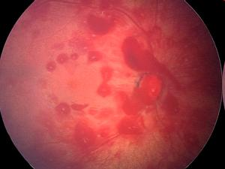
Retinal hemorrhages
www. dontshake.org
Notes:
Notes: retinal hemorrhages can also occur with accidental trauma. Retinal hemorrhages that are associated with inflicted injury such as shaking are often in multiple layers of the retina and extend to the periphery. Consider referral to an ophthalmologist (eye doctor) if possible
Specific reference: [www. dontshake.org] Accessed November 14, 2011

Slide 43
Subdural hemorrhages: Differential diagnosis
Accidental or abusive head trauma
Birth trauma
Congenital malformations
Bleeding disorder or Vitamin K deficiency
Infection (eg, meningitis)
Metabolic disorders
Tumor
Vasculitis
Notes:
Notes: Birth trauma is a rare cause of subdural hemorrhages
Specific Reference: Sirotnak, AP et al. Physical Abuse of Children. Pediatrics in Review. 2004; 25(8): 264-277.

Slide 44
Investigations for head injury
Fundoscopy, XR and/or CT head:
  For children with suspected abusive head injury
  All asymptomatic children < 1year with other injuries highly suspicious of abuse
If subdural hemorrhage found:
  Work-up for bleeding disorder
  Skeletal survey
Notes:
Notes: Fundoscopy means eye exam. If available, it is preferable to image those children suspected of having an abusive head trauma with a CT scan because some subdural hemorrhages may require surgical drainage, if it is possible. It is also recommended to image the heads of all children less than 1 year who are at high risk of having been abused. This is because the signs of head injury can be subtle in this age group. If a subdural hemorrhage is found, the child should also have investigations for a bleeding disorder (platelets, coagulation studies, bleeding time) or other potential causes, e.g. infection. In addition, a skeletal survey or at least xrays of the ribs might be helpful to look for other injuries.
Specific Reference: Kellogg, N. Evaluation of Suspected Child Physical Abuse. Pediatrics. 2007;119:1232-1241.

Slide 45
Other injuries to consider…
Injuries to abdominal organs, kidneys or chest
  Rupture of liver, spleen or intestines
May not have external evidence of injury
Usually result from direct blow
Consider AST, ALT, amylase, lipase, urinalysis (if possible) or abdominal imaging
Notes:
Specific Reference: Sirotnak, AP et al. Physical Abuse of Children. Pediatrics in Review. 2004; 25(8): 264-277. Kellogg, N. Evaluation of Suspected Child Physical Abuse. Pediatrics. 2007;119:1232-1241.

Slide 46
Sexual Abuse

Slide 47
Sexual Abuse
Oral-genital, genital, or anal contact by or to the child
Exhibitionism, voyeurism, or child pornography
Perpetrator is adult or child who is older or at a higher developmental level
  Usually known to the child e.g. caregiver, stepparent, relative, teacher, coach, neighbour
  Often threatens
Notes:
Notes: Exhibitionism means to derive sexual pleasure from displaying your genitals, voyeurism means to derive sexual pleasure from observing the genitals of another person without their consent
Specific reference: Kellogg N, American Academy of Pediatrics Committee on Child Abuse and Neglect. The evaluation of sexual abuse in children. Pediatrics. 2005;116(2):506-512.

Slide 48
Sexual Play – Can be Normal
Viewing or touching of the genitalia, buttocks, or chest by children who are at the same developmental stage
Children are approximately within 4 years of age of each other
Notes:
Notes: It is important to tell the difference between sexual abuse and sexual play. Sexual play can be a normal part of a child’s development.
Specific References: Kellogg N, American Academy of Pediatrics Committee on Child Abuse and Neglect. The evaluation of sexual abuse in children. Pediatrics. 2005;116(2):506-512. Felzen, C. Sexual Abuse in Children. Pediatrics in Review. 2006; 27:17-27.

Slide 49
Case 3: Mary, 5 year old girl
Brought in by mother for complaints of painful urination
Mother has noted that her genital area is red and she is having vaginal discharge
Mary has restarted sucking her thumb and frequently complains of stomach pains
She has been caught exposing her genitalia to other children in the neighbourhood

Slide 50
Discussion points
How concerned are you about sexual abuse?
What are red flags for sexual abuse in this case?
Notes:
Notes: Discussion about this case. This case is concerning for sexual abuse for several reasons: Mary is having symptoms and signs in her genital area, has shown regression in behaviour (thumb-sucking) and is having general complaints ie stomach pains that may signify distress. The fact that she is sexually acting out is also a red flag for sexual abuse. In this case, other diagnoses to consider are a urinary tract infection or vulvovaginitis (inflammation/infection of the vulvar skin)

Slide 51
Suspect sexual abuse when…
Injury or complaints in genital area
History of general complaints
  anxiety, enuresis, encopresis, decrease in school performance, depression, and behavior problems
Sexually transmitted disease or pregnancy
Frequent unexplained sore throats, yeast or urinary infections
Child engaged in developmentally inappropriate sexual behavior
Notes:
Notes: Complaints in the genital area can be bleeding, pain, discomfort, itchiness. General complaints include frequent abdominal pain or headache without a physical cause, or having new stool or urine incontinence. Frequent sore throats might be a sign of pharyngeal gonnorhea.
Specific Reference: Kellogg N, American Academy of Pediatrics Committee on Child Abuse and Neglect. The evaluation of sexual abuse in children. Pediatrics. 2005;116(2):506-512. Felzen, C. Sexual Abuse in Children. Pediatrics in Review. 2006; 27:17-27.

Slide 52
History
Be supportive and believing
Ask neutral questions e.g “Has someone ever touched you in a way you didn't like or that made you feel uncomfortable?"
Avoid repetitive interviews
May use drawings with younger children
Document clearly
Notes:
Note: Talking about the abuse can be difficult for children. Be careful not to re-traumatize the child. It may be best if a professional interviewer does the interviewing.
Specific Reference:
Kellogg N, American Academy of Pediatrics Committee on Child Abuse and Neglect. The evaluation of sexual abuse in children. Pediatrics. 2005;116(2):506-512.
Aggarwal K, Dalwai S, Galagali P, Mishra D, Prasad C, Thadhani A; Child Rights And Protection Program (CRPP) of Indian Academy of Pediatrics (IAP). Recommendations on recognition and response to child

Slide 53
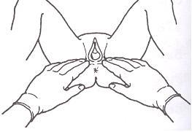
Physical Exam
No internal exam for preadolescent girls
The anal examination is external
Document clearly on
  diagram
Only urgent if within 72 hours or if injuries
Best to have non-offending caregiver present
Full exam, including mouth, breasts, genitals, buttocks, and anus
Examine girls in frog leg position or knee chest position
  Use gentle traction on the labia majora to visualize hymen
http://www.smj.ejnal.com/e-journal/word/picture/article/smj/218/Srinaree5.JPG
Notes:
Notes: A physical exam is considered “urgent” if the alleged assault occurred within 72 hours or if there are injuries which require treatment. A “rape kit” should be done if within 72 hours of an alleged assault. If possible, you might consider consulting a specialist to do the exam.
Ideally, a supportive caregiver or parent is present for the exam, but it is best if the caregiver is not suspected to be the perpetrator.
The frog leg position is illustrated in this picture.
Adolescent girls who report penetration should have a bimanual examination and a speculum exam but an internal examination is usually not recommended for preadolescent girls.
Specific Reference: Kellogg N, American Academy of Pediatrics Committee on Child Abuse and Neglect. The evaluation of sexual abuse in children. Pediatrics. 2005;116(2):506-512. Felzen, C. Sexual Abuse in Children. Pediatrics in Review. 2006; 27:17-27. [http://www.smj.ejnal.com/e-journal/word/picture/article/smj/218/Srinaree5.JPG] Accessed March 6, 2012

Slide 54
Quiz Question 4
What is the most common exam finding among children who have been sexually abused?
  Normal exam
  Complete tear of the hymen
  Bruises of genital area
  Pregnancy
Notes:
Correct Answer: normal exam, the other findings may be present but only rarely. Even after penetration, there may be no changes seen in the hymen.
Specific Reference: Heger A et al. Children referred for possible sexual abuse: medical findings in 2384 children. Child Abuse & Neglect. 2002;26(6-7):645.

Slide 55
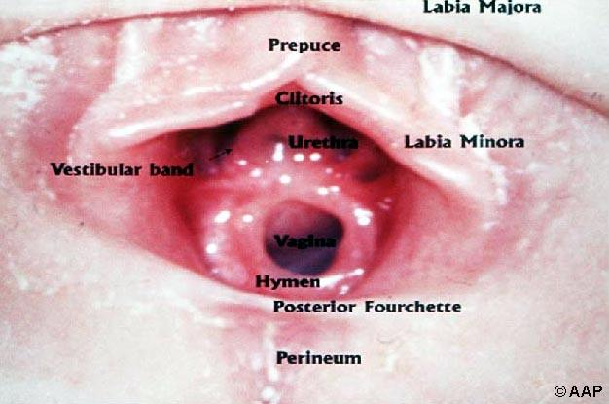
Normal Female Genital Anatomy
www.pediatriccareonline.org
Notes:
Note: the hymen can have different shapes, the size of the hymenal opening is variable
Specific Reference:[www.pediatriccareonline.org] Accessed February 7, 2012

Slide 56
Concerning Physical Findings
Cuts or bruising of the genitalia
Anal bruising or lacerations
For girls: tearing (especially if complete) or significantly decreased amount of tissue in the posterior (inferior) aspect of hymen between the 3 and 9 o’clock positions (bottom half)
Semen deposition
Notes:
Notes: Although these are concerning findings they also may be present in children who have not been abused but who have undergone accidental injury. When examining a girl’ s hymen, it is important to be aware of the normal variations that may be found, such as notches or clefts.
Specific References: Kellogg N, American Academy of Pediatrics Committee on Child Abuse and Neglect. The evaluation of sexual abuse in children. Pediatrics. 2005;116(2):506-512.

Slide 57
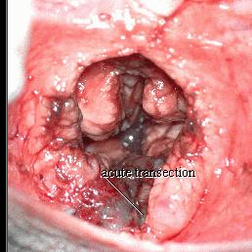
Concerning Physical Finding
www.pediatriccareonline.org
Notes:
Note: acute transection of hymen, it suggests trauma but this can be trauma from sexual abuse or an accidental trauma such as a straddle injury. A straddle injury can occur if an individual falls on something between their legs.
Specific Reference:[www.pediatriccareonline.org] Accessed February 7, 2012

Slide 58
Differential diagnosis
Accidental or self-inflicted trauma
Irritants
Skin infections/vulvovaginitis
Female circumcision
Constipation
Notes:
Note: Please note that vulvovaginitis is the most common reason for painful urination and vulvar complaints in the child
Specific Reference: Adams, JA. Medical evaluation of suspected child sexual abuse. Journal of Pediatric and Adolescent Gynecology. 2004; 17:191.

Slide 59
Quiz Question 5
Which of these sexually transmitted infections is most suggestive of sexual abuse in a preadolescent child?
  Genital scabies
  Hepatitis B
  Chlamydia
  Gardnerella vaginalis
Notes:
Correct answer: Genital chlamydia, gonorrhea, trichomonas vaginalis, HIV and syphilis infections are considered diagnostic for sexual abuse except for cases of perinatal transmission. Although the other infections can also be caused by abuse, they are less suggestive of abuse. Hepatitis B can be caused by vertical transmission or contact with blood. Genital scabies and gardnerella vaginalis can spread through non-sexual contact.
Specific Reference: American Academy of Pediatrics. Red Book: 2009 Report of the Committee on Infectious Diseases; Adams, J. Medical Evaluation of Suspected Child Sexual Abuse: 2011 Update. Journal of Child Sexual Abuse; 2011: 20: 588-605.

Slide 60
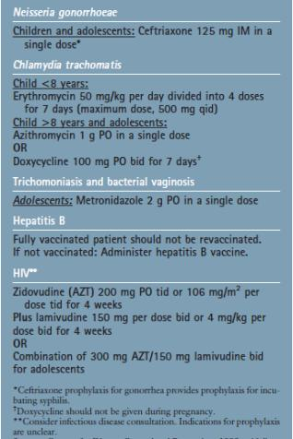
Treatment after sexual abuse
Test for and prevent sexually-transmitted infections
Pregnancy test
Emergency contraception for non-pregnant adolescents if within 120 hours of assault
Arrange support and follow-up
American Academy of Pediatrics. Red Book:
2009 Report of the Committee on Infectious Diseases.
Notes:
Notes: In cases where penetration or genital contact has occurred, you should test children for STIs. You should also consider treating them even before getting the results, especially in the case of postpubertal children. For postpubteral girls, you should give them a pregnancy test and emergency contraception, if it has been less than 5 days since the assault. If the assault occurred in the previous 72 hours and there is a high chance of exposure to HIV infection, you should consider offering one month of HIV medications to prevent infection.
Specific Reference: American Academy of Pediatrics. Red Book: 2009 Report of the Committee on Infectious Diseases.

Slide 61
Consequences of abuse
Mental health problems
  depression, substance abuse, suicidality, anxiety
Behavioral behaviours
  smoking, high-risk sexual behaviours, unintended pregnancy, violence
Cognitive problems
  poor school performance
Notes:
Note: consider whether the child may need referral for support services or counseling
Specific References: Felzen, C. Sexual Abuse in Children. Pediatrics in Review. 2006; 27:17-27. World Health Organization & International Society for Prevention of Child Abuse and Neglect (2006). Preventing Child Maltreatment: a guide to taking action and generating evidence. [http://www.ispcan.org/resource/resmgr/docs/preventing_child_maltreatmen.pdf] Accessed August 23, 2011.

Slide 62
Discussion Points: Local Practices
Are there any other types of practices in your area that might be considered abuse?
How is corporal punishment/physical discipline in schools and homes viewed?
  Is it accepted? Is it encouraged?
What is our role as health care practitioners in changing attitudes/practices?
Notes:
Notes: There is significant variation worldwide in what is considered abuse.
Examples of other types of practices that might be considered abuse are child soldiers, forced marriages of young girls, child labour, female circumcision
Our role as health care practitioners is to make sure that children are safe and protected. Does anyone have any suggestions as to how we could promote child safety and protection in our community?

Slide 63
Reporting
Consider consulting a pediatrician with expertise in abuse investigations
If you suspect abuse and/or neglect, you should report to local authorities
Ensure the child’s safety before you discharge s/he from the emergency room
Consider the danger posed to other children in the home
Notes:
Instruction: please inform yourself about how reporting works in your area so that you can discuss it at this time. Whom do you report to? What is the procedure to report?

Slide 64
Summary
Physical and sexual abuse are common
Consider abuse if the history is inconsistent with injuries or if the injuries are suspicious
Report to authorities if abuse is suspected
Provide a supportive and safe environment for children
Notes:
Notes: As emergency providers, we are at the frontline of recognizing potential cases of abuse. We need to keep a high index of suspicious and recognize potential red flags for abuse on history and physical exam. By investigating for abuse and reporting to authorities, we may be able to prevent further abuse to children.

Slide 65
General References: Journal articles
Adams, J. Medical Evaluation of Suspected Child Sexual Abuse: 2011 Update. Journal of Child Sexual Abuse; 2011: 20: 588-605.
Adams, JA. Medical evaluation of suspected child sexual abuse. Journal of Pediatric and Adolescent Gynecology. 2004; 17:191.
Aggarwal K, Dalwai S, Galagali P, Mishra D, Prasad C, Thadhani A; Child Rights And Protection Program (CRPP) of Indian Academy of Pediatrics (IAP). Recommendations on recognition and response to child abuse and neglect in the Indian setting. Indian Pediatr. 2010 Jun;47(6):493-504.
Akmatov, MK. Child abuse in 28 developing and transitional countries-results from the Multiple Indicator Cluster Surveys. International Journal of Epidemiology. 2011: 219-227.
Asnes, A. et al. Managing Child Abuse: General Principles. Pediatrics in Review. 2010;31;47
Felzen, C. Sexual Abuse in Children. Pediatrics in Review. 2006; 27:17-27.
Gilbert, R et al. Burden and consequences of child maltreatment in high-income countries. Lancet. 2009; 373:68.
Heger A et al. Children referred for possible sexual abuse: medical findings in 2384 children. Child Abuse & Neglect. 2002;26(6-7):645.
Kellogg, N. Evaluation of Suspected Child Physical Abuse. Pediatrics. 2007;119:1232-1241.
Kellogg N, American Academy of Pediatrics Committee on Child Abuse and Neglect. The evaluation of sexual abuse in children. Pediatrics. 2005;116(2):506-512.
Maguire, S. Which injuries may indicate child abuse? Arch Dis Child Educ Pract Ed. 2010, 95: 170-177.
Pandya, NK et al. Child Abuse and Orthopaedic Injury Patterns: Analysis at a Level I Pediatric Trauma Center. Journal of Pediatric Orthopedics. 2009; 29(6): 618-624.
Sirotnak, AP et al. Physical Abuse of Children. Pediatrics in Review. 2004; 25(8): 264-277.

Slide 66
General References: Web links
Endom, E. Physical abuse in children: Epidemiology and clinical manifestations. UpToDate. 2011. [www.uptodate.com] Accessed November 11, 2011
Use and utility of radiology in the work up of suspected child abuse. [http://www.meddean.luc.edu/lumen/MedEd/radio/curriculum/Pediatrics/child_abuse.htm] Accessed November 11, 2011.
Radiology.med.sc.edu [http://radiographics.rsna.org/content/23/4/811/F17.large.jpg] Accessed November 11, 2011.
Scherl, SA et al. Differential diagnosis of the orthopedic manifestations of child abuse. UpToDate. 2011 [www.uptodate.com] Accessed November 11, 2011.
World Health Organization & International Society for Prevention of Child Abuse and Neglect (2006). Preventing Child Maltreatment: a guide to taking action and generating evidence. [http://www.ispcan.org/resource/resmgr/docs/preventing_child_maltreatmen.pdf] Accessed August 23, 2011.
United Nations Convention on the Rights of the Child, 1989. [http://www.unicef.org/crc/] Accessed November 11, 2011.
[www. dontshake.org] Accessed November 14, 2011
Child Protection and the Dental Team. Recognizing abuse and neglect
[http://www.cpdt.org.uk/tab02/2_4_1_0.htm] Accessed November 15, 2011.
[http://www.med.pdn.ac.lk/departments/forensic/BUDHUSARANAI/blast-ansr.html] Accessed November 15, 2011.
www.pediatriccareonline.org. Accessed February 17, 2012.
http://www.aafp.org/afp/2000/0515/afp20000515p3057-f2.jpg. Accessed February 17, 2012
http://www.smj.ejnal.com/e-journal/word/picture/article/smj/218/Srinaree5.JPG accessed march 6, 2012

Slide 67
General References: Other
American Academy of Pediatrics. Red Book: 2009 Report of the Committee on Infectious Diseases.
CPS, Multidisciplinary Guidelines on the Identification, Investigation and Management of Suspected Abusive Head Trauma, 2008.

